Slide 1




Power BI
Manager Guide
Prepared By :
Said Fawzy
Manager of Information Center
Tendering Department
Arab Contractors

Slide 2
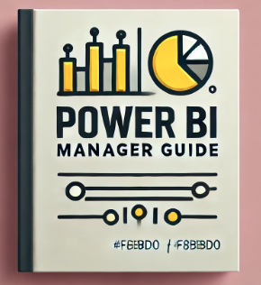
Course Introduction

Slide 3



Slide 4

Prerequisites
Good Command of your business need.

Slide 5

Course Objectives
By the end of this two-day training, participants will:
1️. Understand Power BI Fundamentals
2️. Explore the Data Analysis Life Cycle in Power BI
3️. Recognize the Types of Reports & Visuals in Power BI
4️. Contribute to Report Design & Dashboard Creation
5️. Apply Power BI to Project Management Scenarios

Slide 6

Benefits of Power BI for Any Business
Its key benefits include:
• Data Integration
• Data Visualization
• Automation & Efficiency
• Better Decision-Making
• Collaboration & Sharing
• Scalability
• Cost-Effective

Slide 7


Slide 8


Slide 9
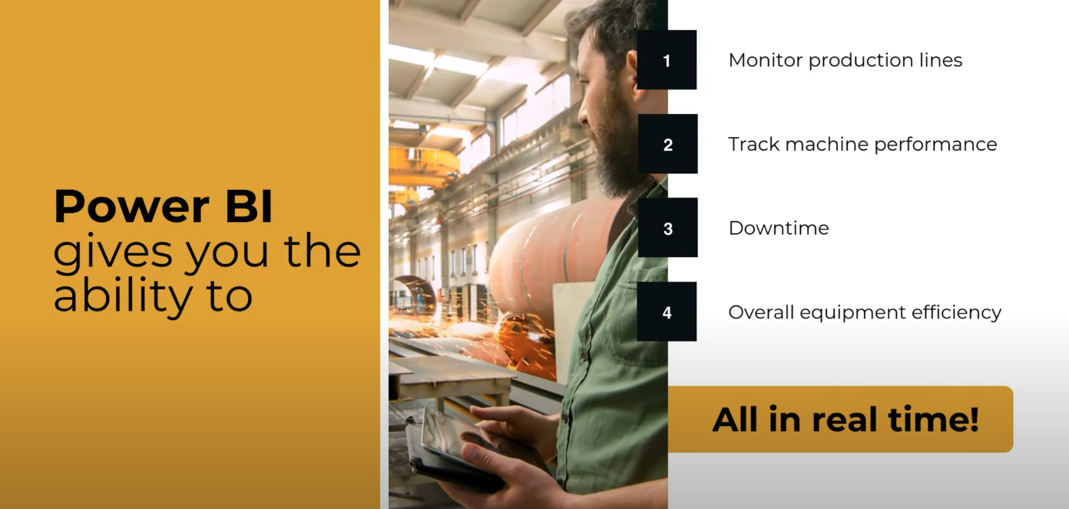

Slide 10
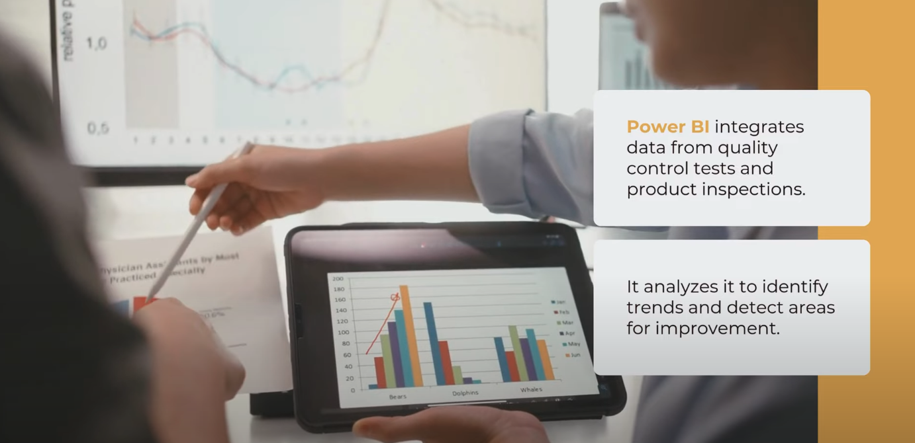

Slide 11
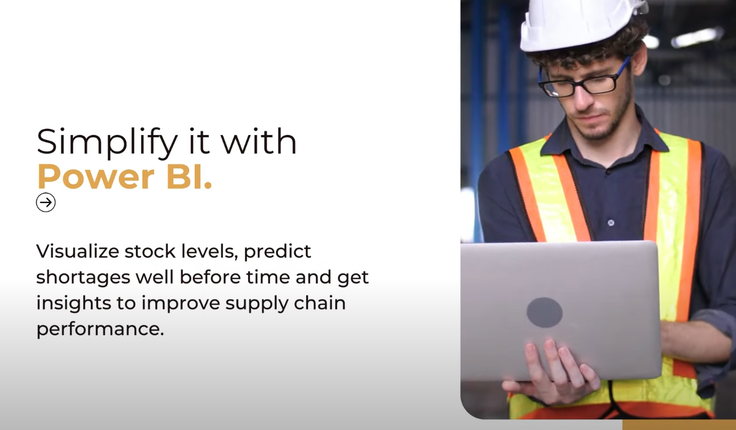

Slide 12
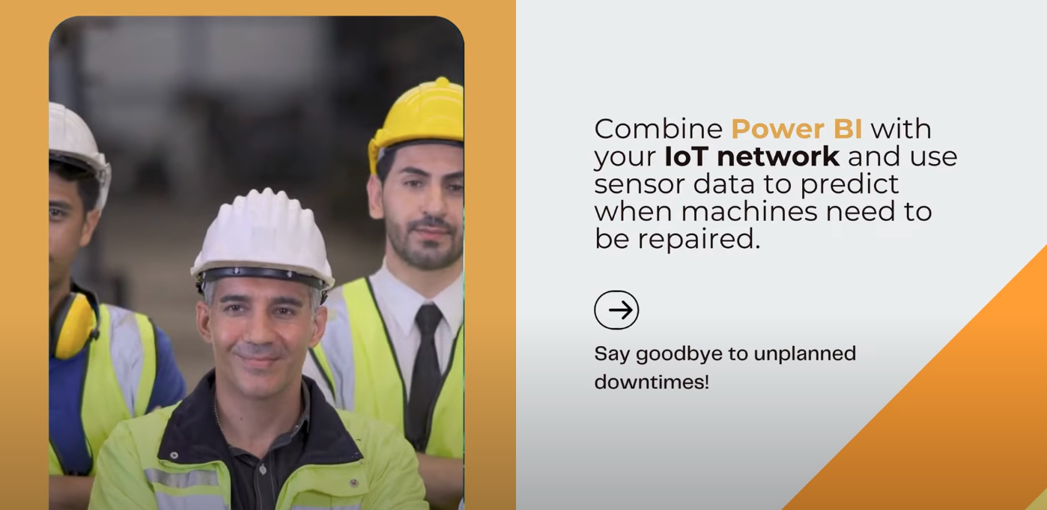

Slide 13
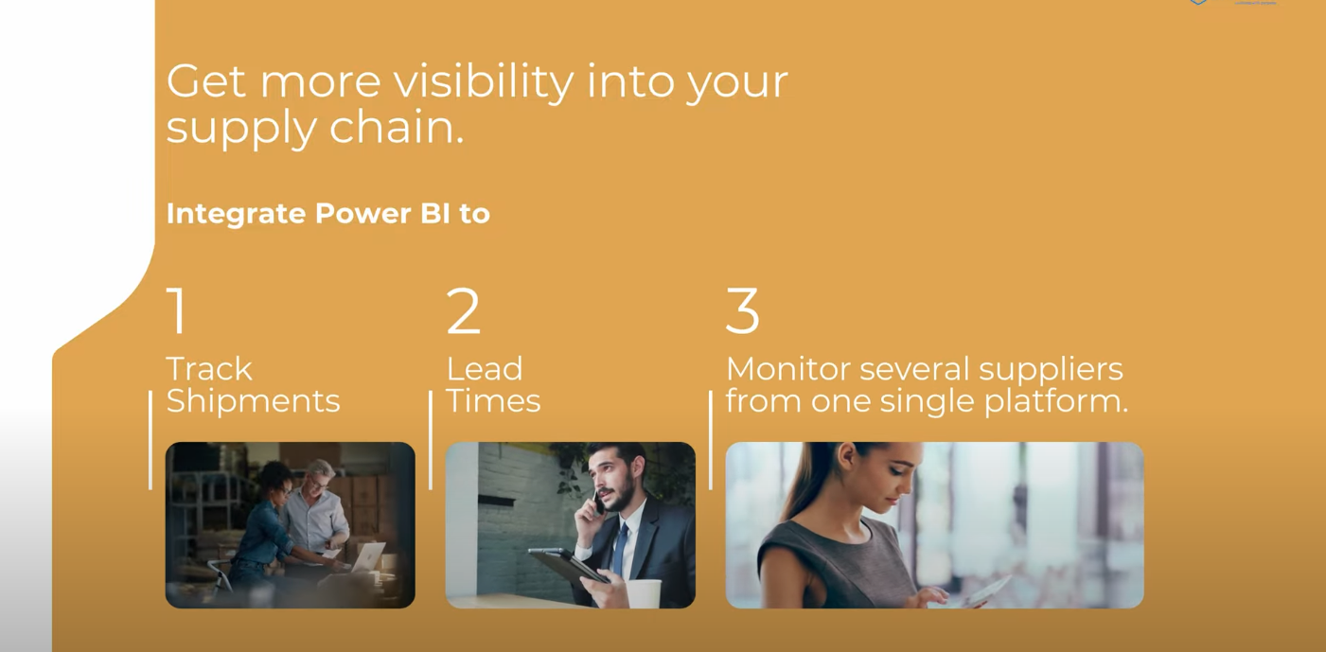

Slide 14
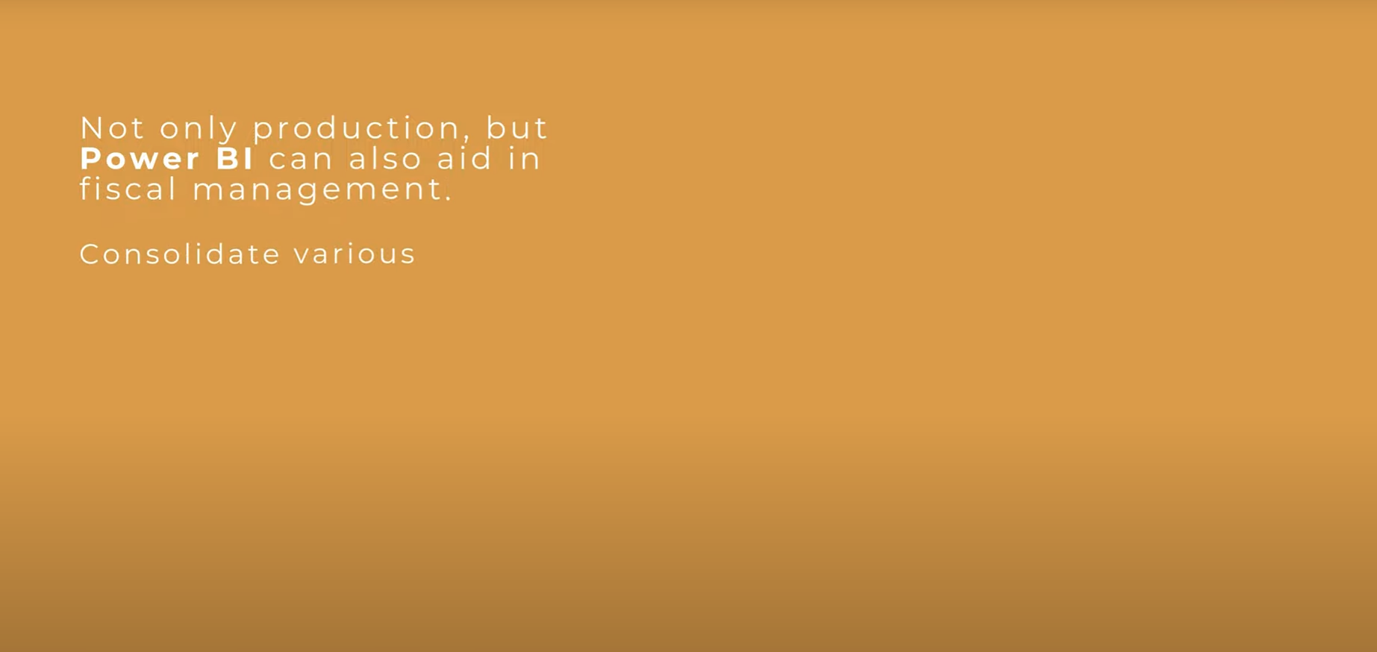

Financial performance reports
Analyze Cost
Cash flows to find areas to increase efficiency.

Slide 15


Slide 16



Slide 17




Slide 18
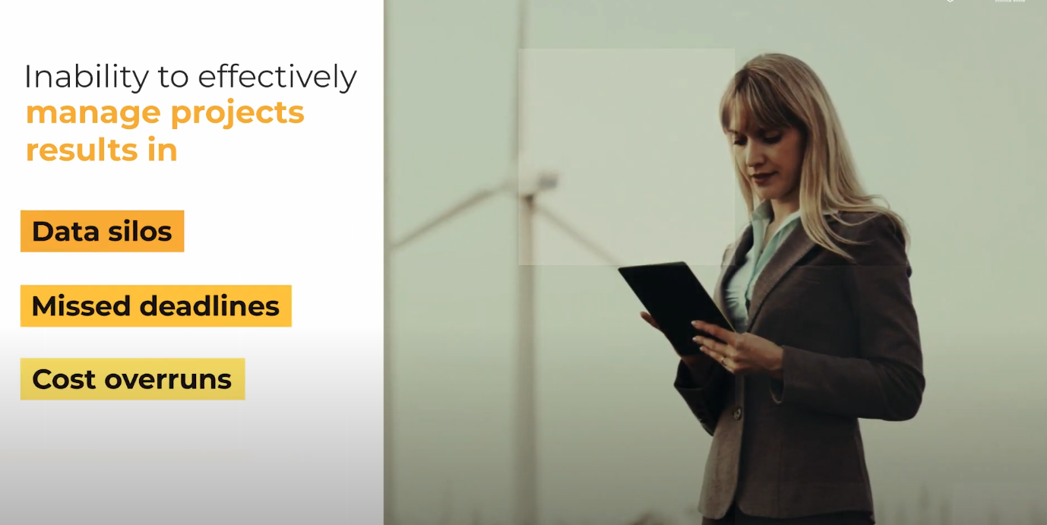

Slide 19
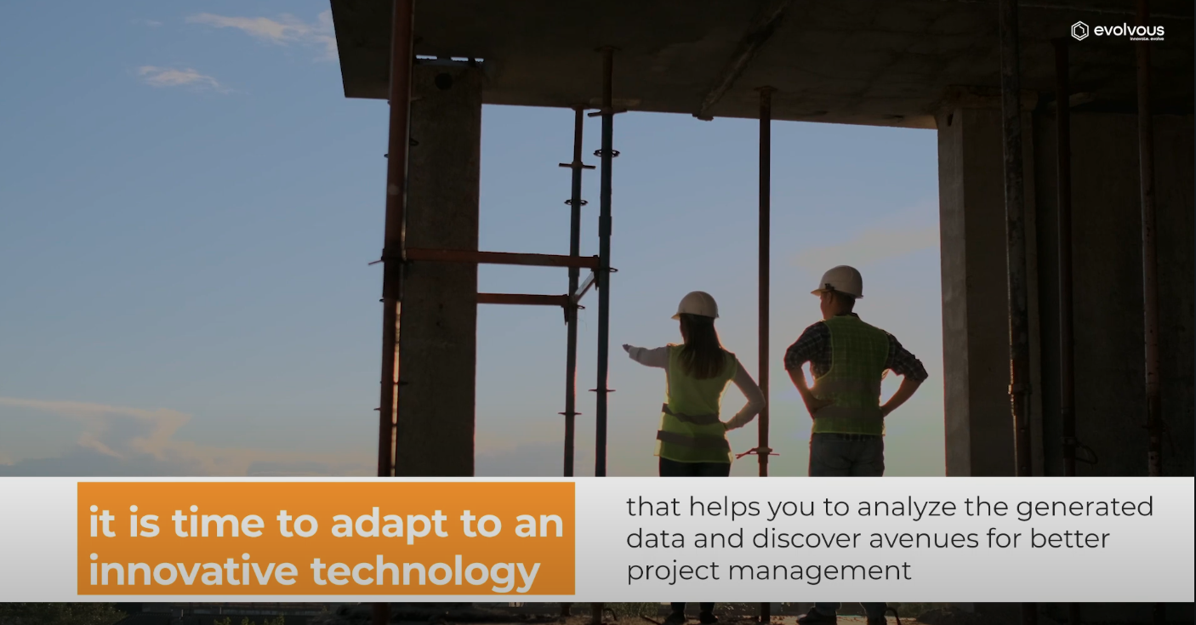

Slide 20
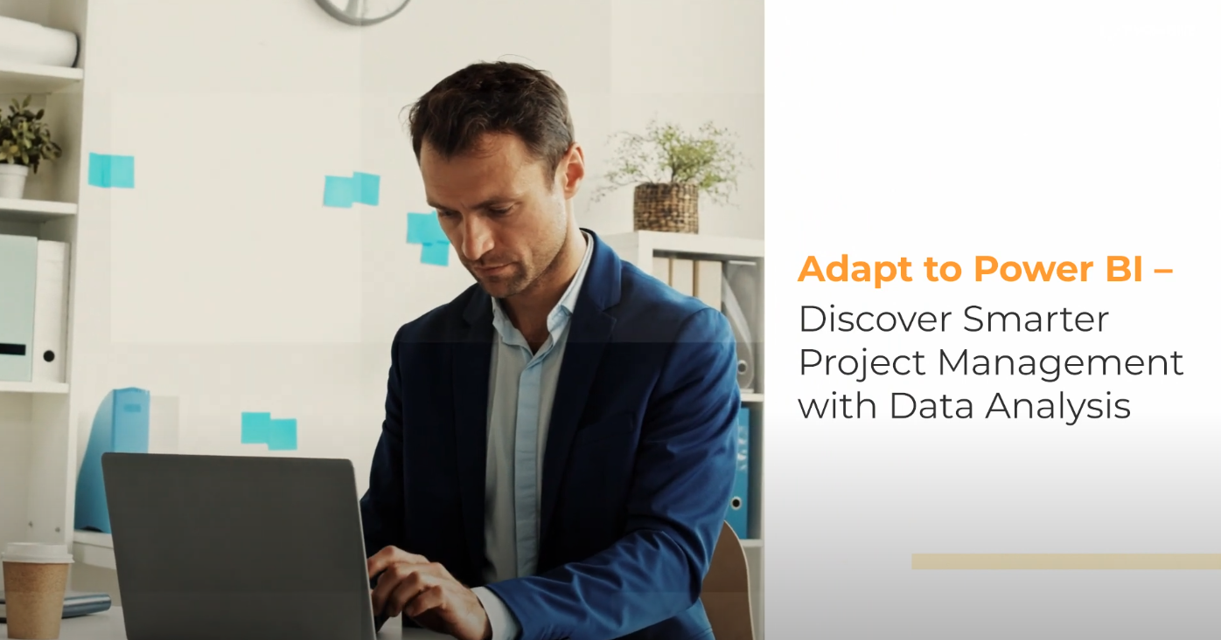

Slide 21
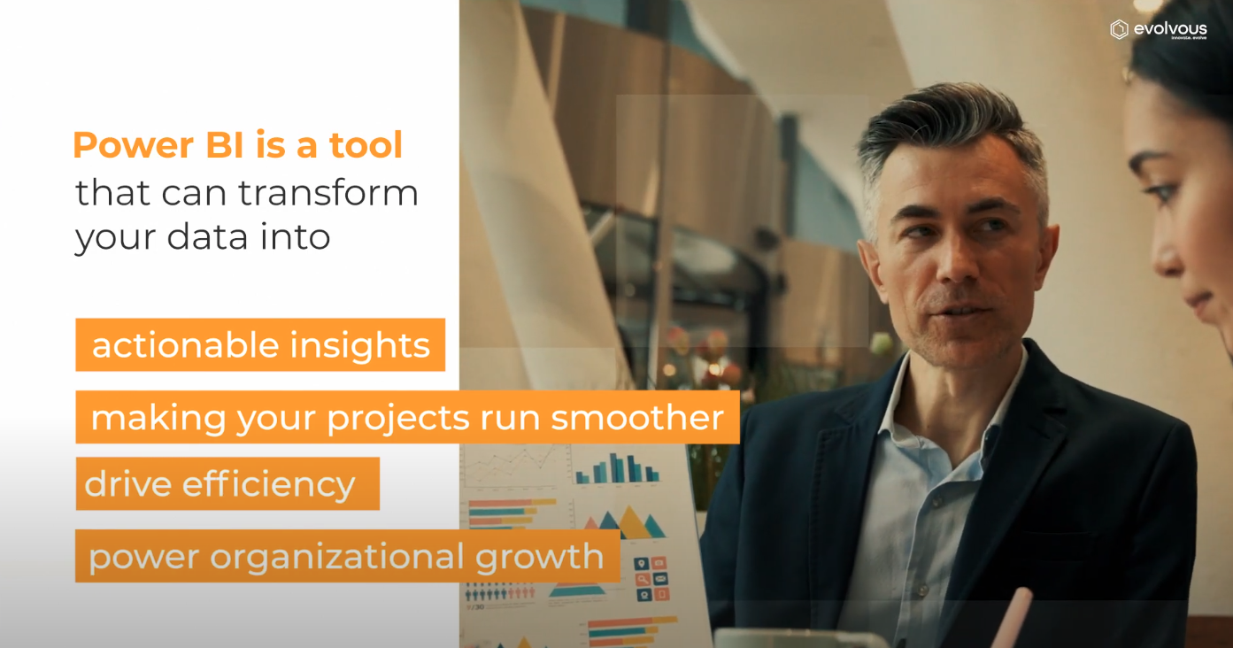

Slide 22
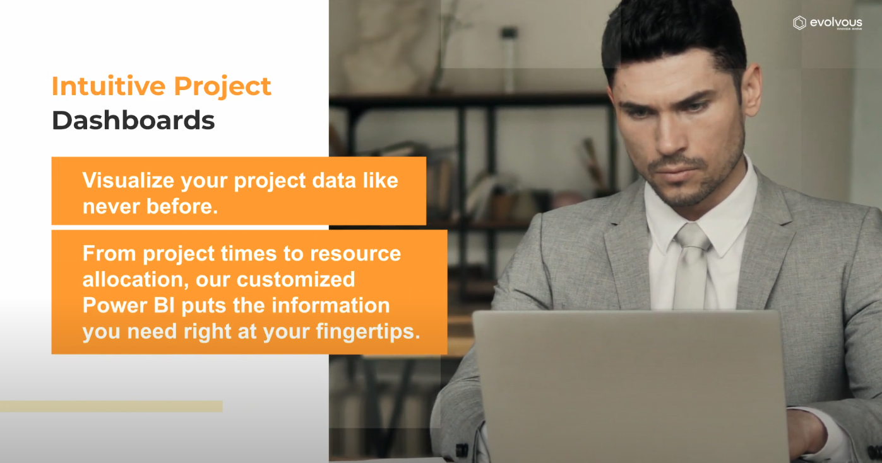

Slide 23
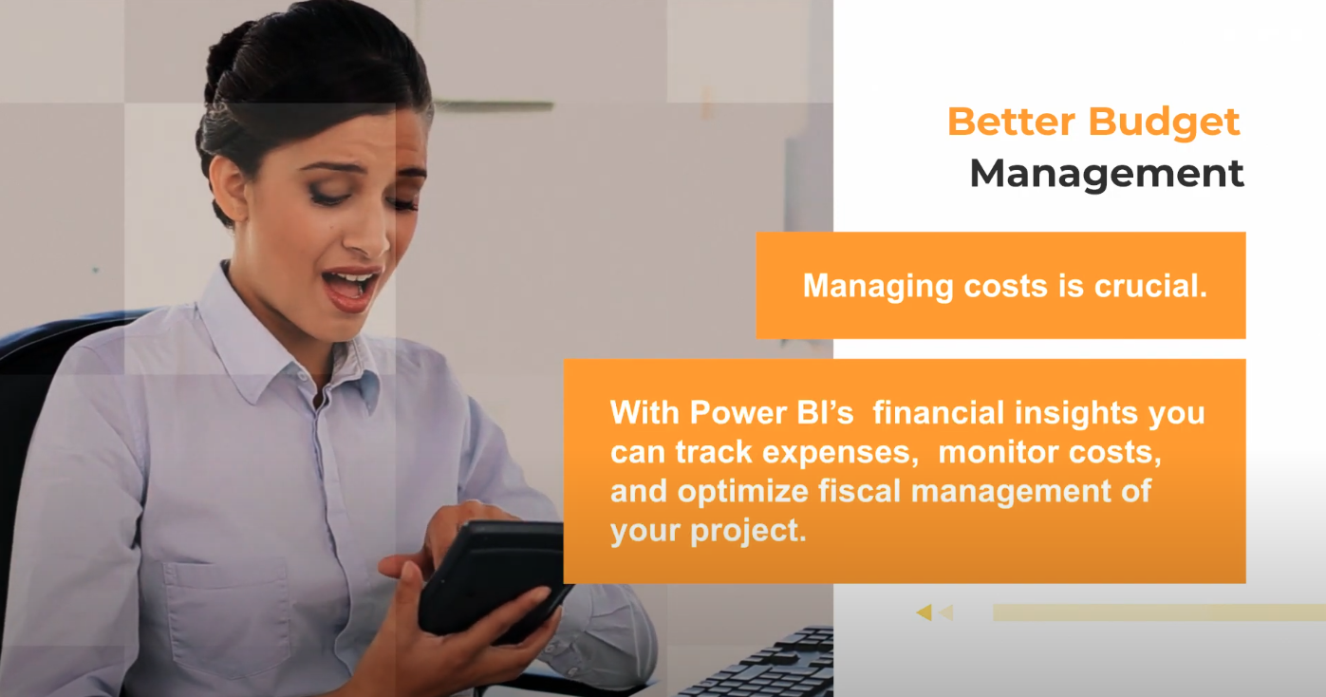

Slide 24
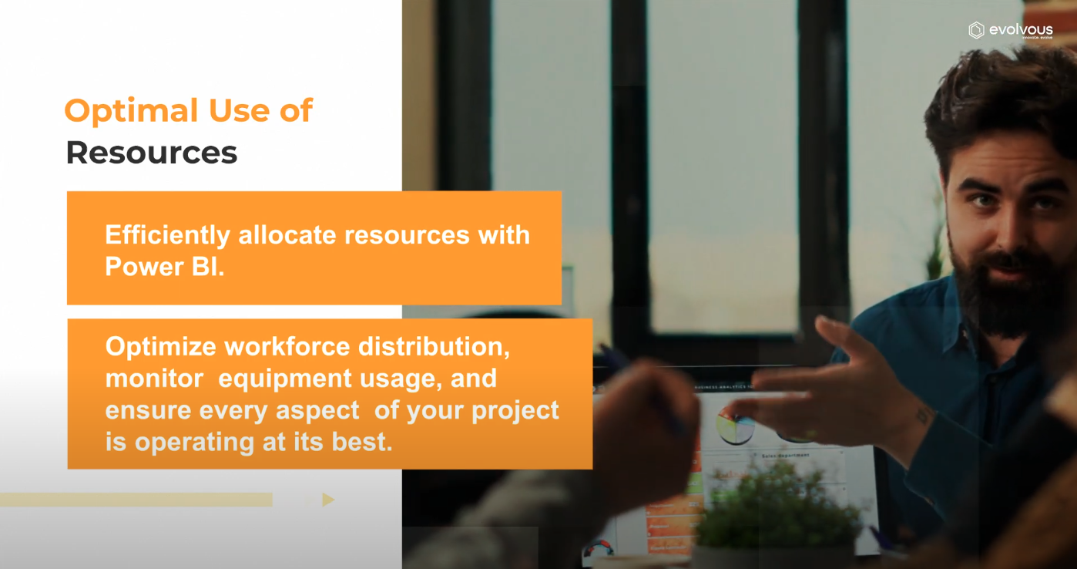

Slide 25
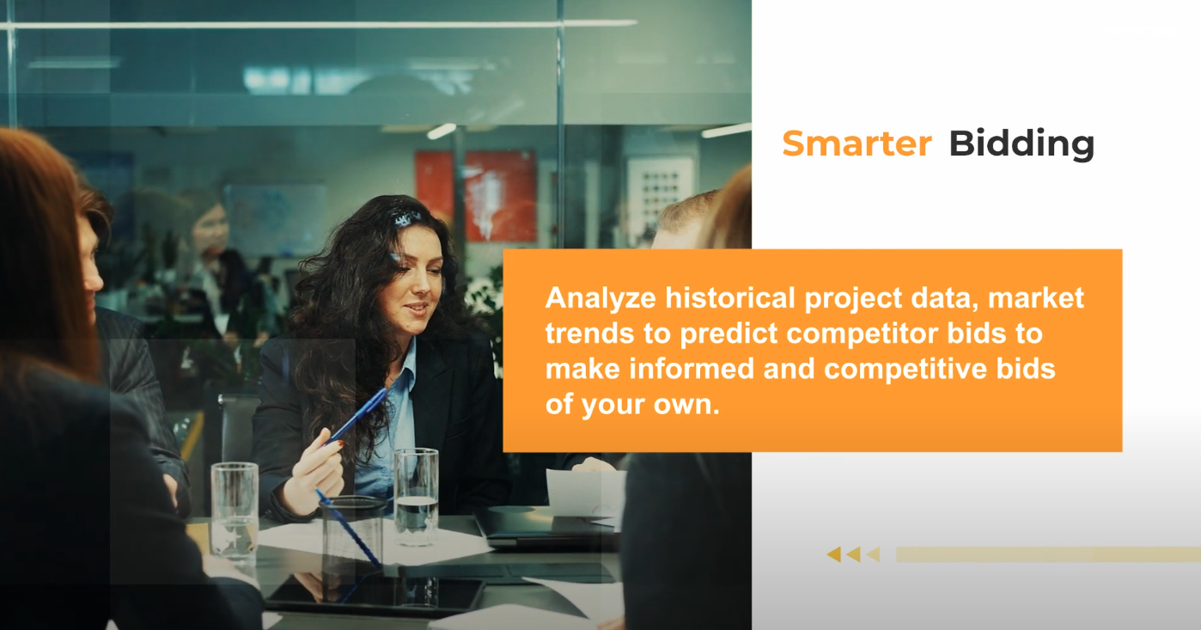

Slide 26
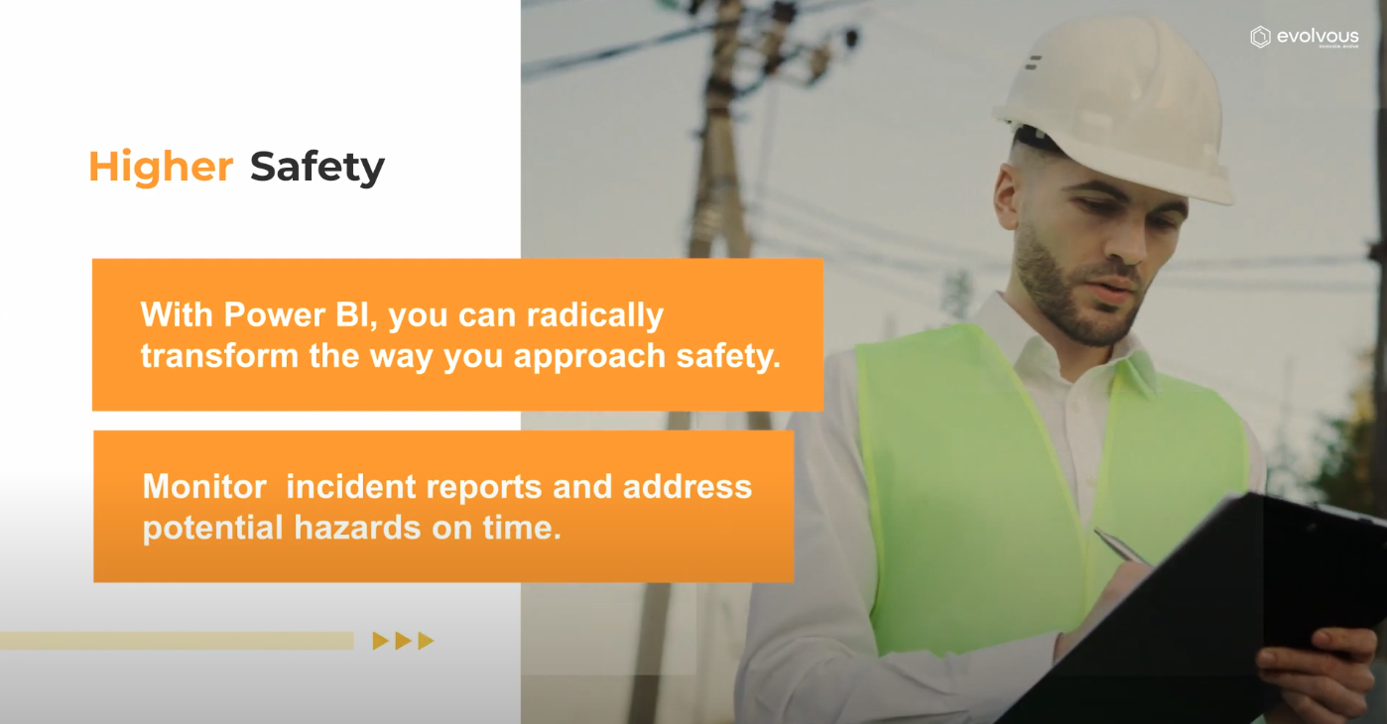

Slide 27
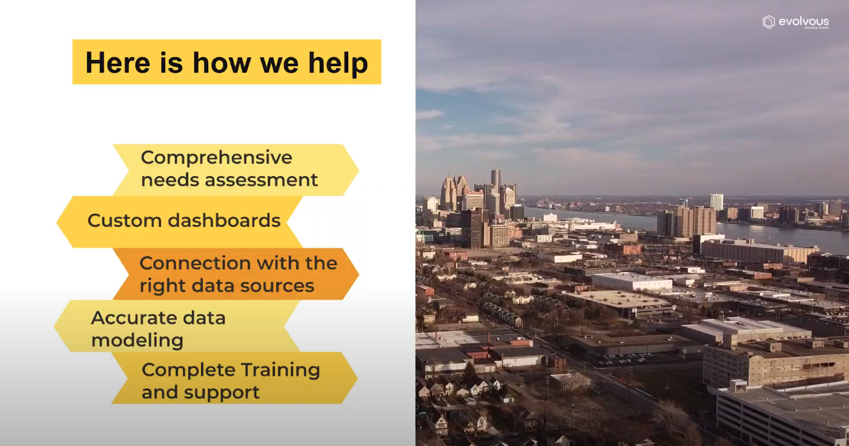
How To Reach That

Slide 28


Slide 29
Chapter 1
Introduction to Power BI
Chapter 2
Preparing Data for Analysis
Chapter 3
Modeling Data
Chapter 4
Visuals
Chapter 5
Power BI Service

Slide 30
Chapter 6
Business Reports Examples

Slide 31


Training
Tell me I will forget.
Show me I might remember something.
Let me do it I will understand.

Slide 32



How would we train?
ACTIVITIES

Slide 33
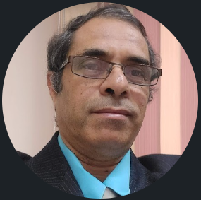

Contact
Cert.
Cert.
Certif.
Quali
JOB
Said Fawzy
Manager of Information Center
Quality Manager
Tendering Department
Arab Contractors

Slide 34
Contact
Cert.
Cert.
Cert.
Quali.
JOB
Said Fawzy
Manager of Information Center
Quality Manager
Tendering Department
Arab Contractors

Slide 35


B.SC In Civil Engineering
1987
Alex University
Contact
Cert.
Cert.
Cert.
Quali.
JOB
Said Fawzy
Manager of Information Center
Tendering Department
Arab Contractors
High Diploma in Construction Project Management
1998
Ein Shams
University

Slide 36
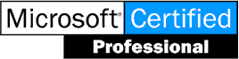


Microsoft Certified Professional (MCP)
1999
B.SC In Civil Engineering
1987
Certified Internet Webmaster(CIW)
2000
Alex University
Contact
Cert.
Cert.
Cert.
Quali.
JOB
Said Fawzy
Manager of Information Center
Tendering Department
Arab Contractors
High Diploma in Construction Project Management
2001
Oracle Certified Master (OCM)
1998
Ein Shams
University
Microsoft Certified Technology Specialist(MCTS)
2006

Slide 37



Microsoft Certified Professional (MCP)
1999
Lead Auditor Quality Management Systems
B.SC In Civil Engineering
2009
1987
Certified Internet Webmaster(CIW)
2000
Alex University
Contact
Cert.
Cert.
Cert.
Quali.
JOB
Said Fawzy
Manager of Information Center
Tendering Department
Arab Contractors
High Diploma in Construction Project Management
2001
Oracle Certified Master (OCM)
1998
Lead Auditor Quality Management Systems
Ein Shams
University
2016
Microsoft Certified Technology Specialist(MCTS)
2006

Slide 38

Advanced Data Analysis Nanodegree
2021
Microsoft Certified Professional (MCP)
1999
Lead Auditor Quality Management Systems
B.SC In Civil Engineering
2009
1987
2022
2000
Nanodegree UX Research Cross-Skilling
Certified Internet Webmaster(CIW)
Alex University
Contact
Cert.
Cert.
Cert.
Quali.
JOB
Said Fawzy
Manager of Information Center
Tendering Department
Arab Contractors
High Diploma in Construction Project Management
2022
2001
Nanodegree Advanced Marketing Analytics
1998
Oracle Certified Master (OCM)
Lead Auditor Quality Management Systems
Ein Shams
University
2016
2023
2006
Microsoft Certified Technology Specialist(MCTS)
IBM Certified Data Analysist Professional

Slide 39
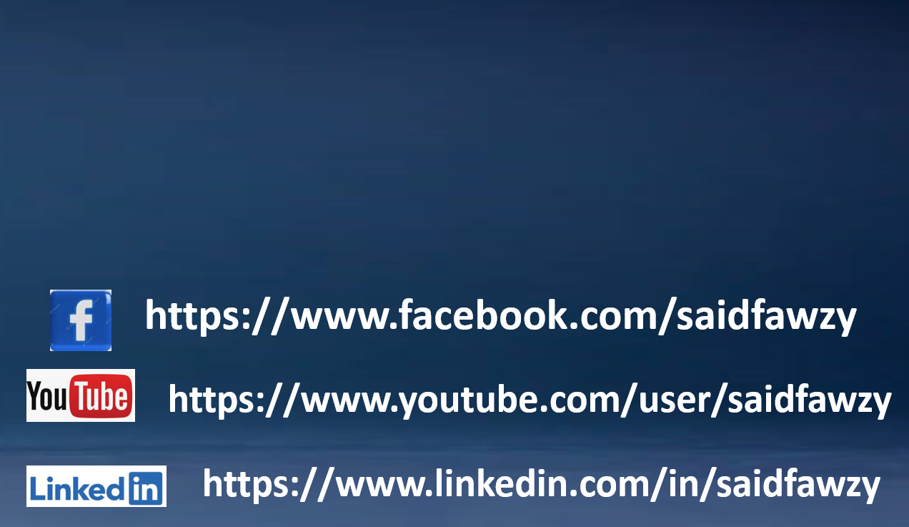

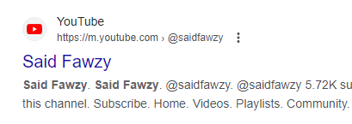
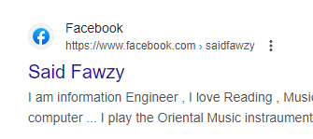
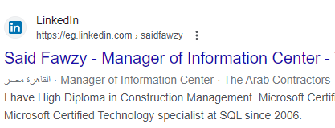


Advanced Data Analysis Nanodegree
2021
Microsoft Certified Professional (MCP)
1999
Lead Auditor Quality Management Systems
B.SC In Civil Engineering
2009
1987
2022
2000
Nanodegree UX Research Cross-Skilling
Certified Internet Webmaster(CIW)
Alex University
Contact
Cert.
Cert.
Cert.
Quali.
JOB
Said Fawzy
Manager of Information Center
Tendering Department
Arab Contractors
High Diploma in Construction Project Management
2022
2001
Nanodegree Advanced Marketing Analytics
1998
Oracle Certified Master (OCM)
Lead Auditor Quality Management Systems
Ein Shams
University
2016
0122 744 99 87
2023
2006
Microsoft Certified Technology Specialist(MCTS)
IBM Certified Data Analysist Professional
Saidfawzy@arabcont.com
Said_fawzy@hotmail.com

Slide 40
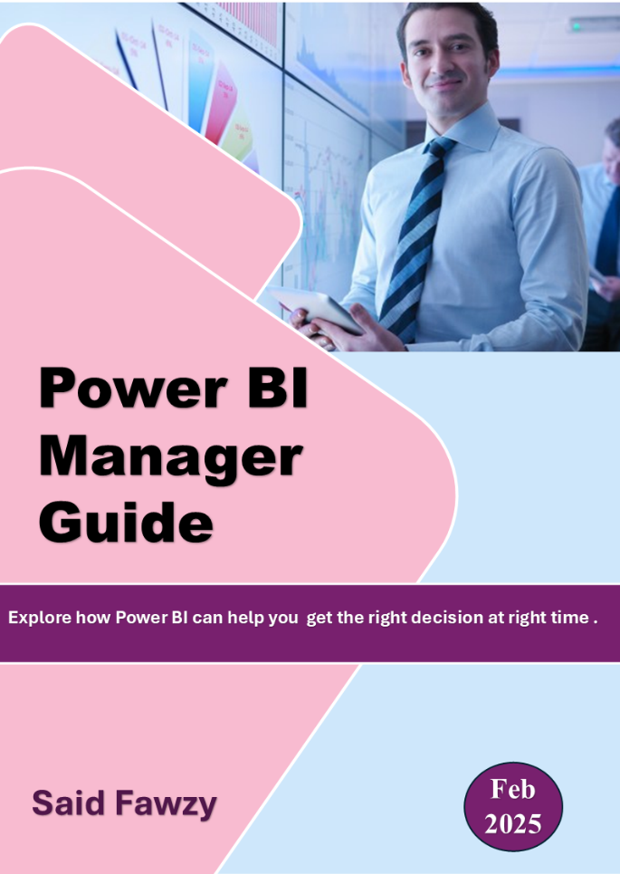
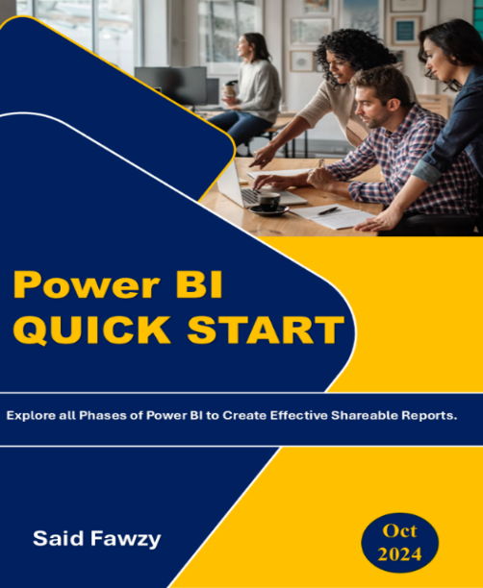
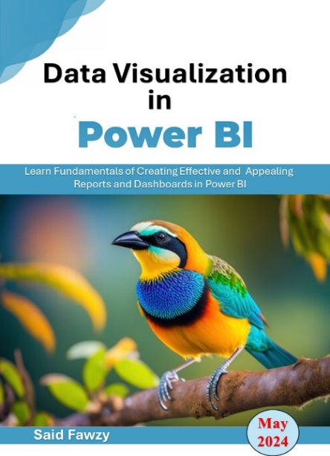

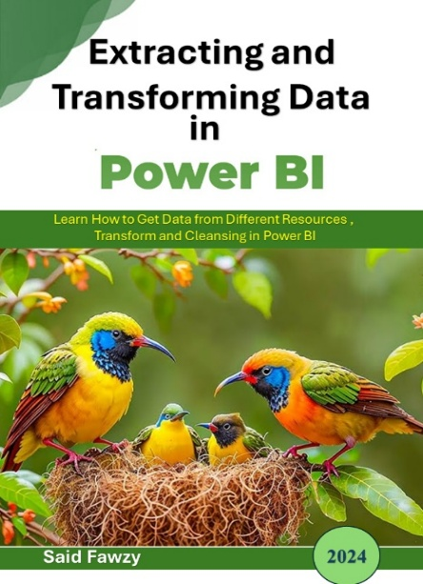
TRAINING ARE BASED ON BOOKS
https://github.com/saidfawzy

Slide 41




JOINE TRAINING GROUPS
Telegram Group
WhatsApp Group
LinkedIn Group
Facebook Group

Slide 42



You are Allowed to Talk
about anything except
Religion
Policy
Soccer

Slide 43


